Slide 1


Members:
Dipak Parshram Edake
Sudarshan Prakash Herwade
Atharva Vikas Kamble
Prem Ganesh Kamble

Slide 2

Dr.Mine:
WEB APP FOR MENTAL HEALTH WELL-BEING

Slide 3
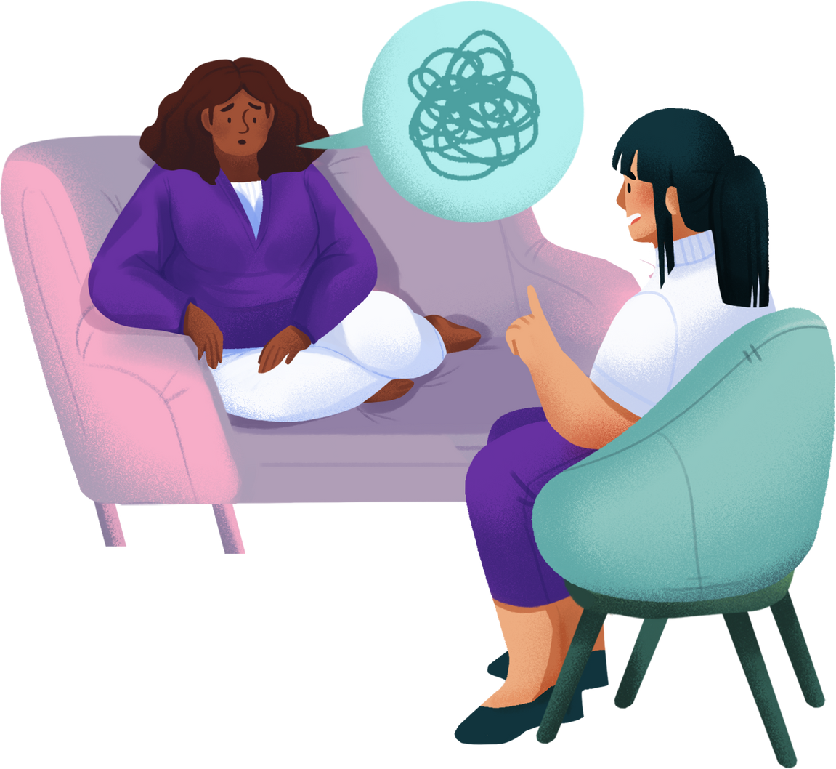
INTRODUCTION:
Dr.Mine offers personalized recommendations for movies, books, music, and meditations tailored to your specific mood. Our Ai chatbot and journaling tools empower you to understand your emotions and build a happier, healthier you.
it's your all-in-one tool for emotional and mental health well-being.

Slide 4

FEATURES:
Recommendation System
Ai chatbot
Journal
Meditation
Profile dashboard

Slide 5

Recommendation System:
Recommendation System recommends movies, books, music according to the specified user mood.
Example: Feeling sad? Dr.Mine suggests uplifting movies, calming music, and help you to find the peace within you with the help of meditation.

Slide 6

Ai Chatbot:
Benefit: Accessible, non-judgmental listening and conversation, promoting emotional well-being and interact with user freely.
Feature: AI chatbot provides 24/7 emotional support and guidance.
Example: Feeling anxious? The chatbot offers calming techniques and encourages positive self-talk.

Slide 7
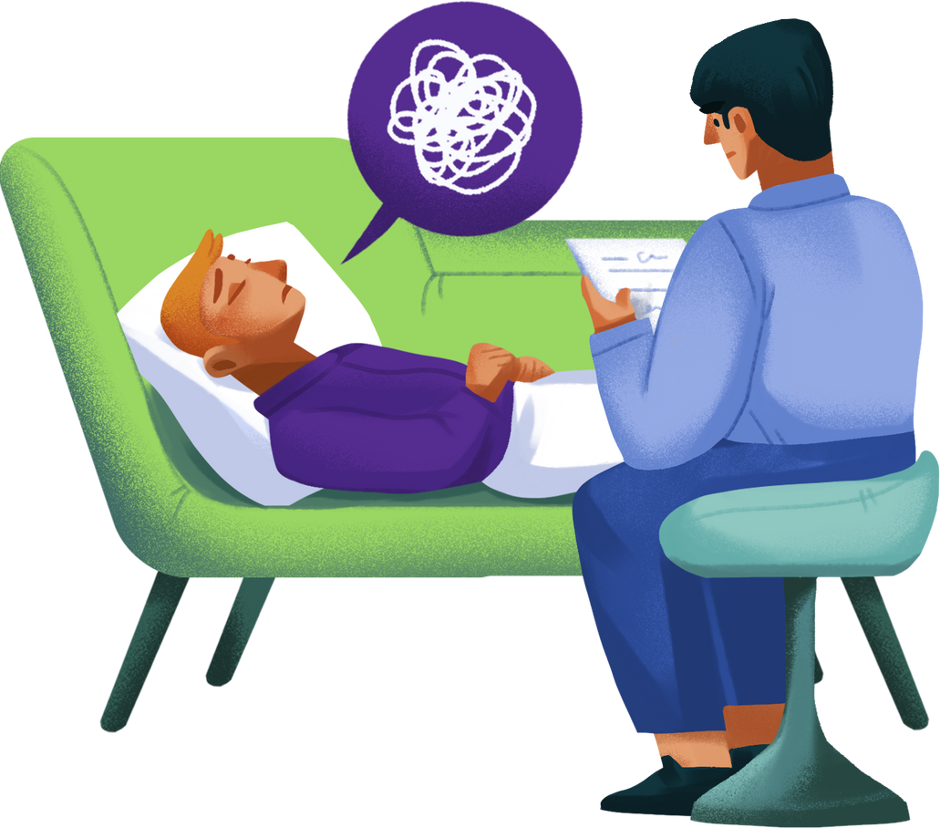
Journal:
A dedicated space for users to express themselves and track their emotional journey.
Promotes self-reflection, emotional processing, and mood management over time.
Users can write about their day, identify triggers, and set goals for improvement.

Slide 8

Meditation Session:
Guided Meditations: Offer a library of guided meditations tailored to different moods, needs, and goals for stress, sleep, focus, and more.
Meditation Timer: Provide a simple timer to facilitate self-guided meditation practice with choose calming sounds, and simply be.
Progress Tracking: Allow users to track their meditation frequency and duration over time.

Slide 9
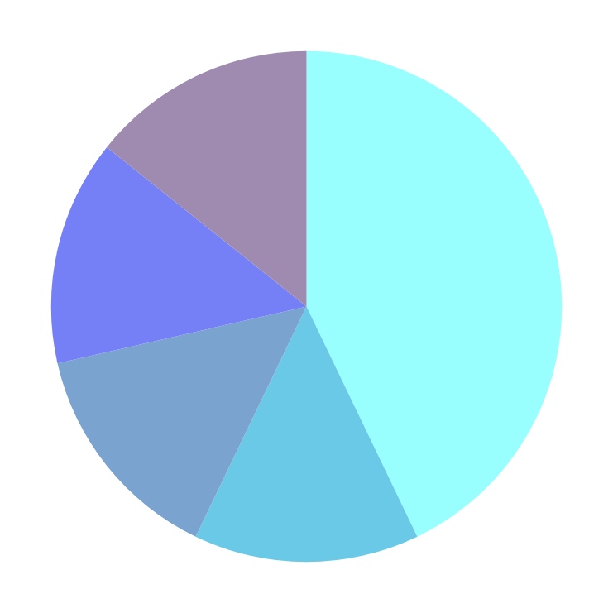
Profile Dashboard
Feature: Visualizes mood trends and progress through interactive graphical circle charts.
Graphical Representation: Show trends in mood over days, weeks, or months.
Privacy and Security: Ensure that user data is displayed securely and privately within the dashboard.
Actionable Insights: Provide suggestions or resources based on the data displayed in the dashboard to empower users to take action and improve their well-being.

Slide 10


Resources
Express
EJS
Mongoose
MongoDB
Database
HTML-CSS for front-end
Packages

Slide 11
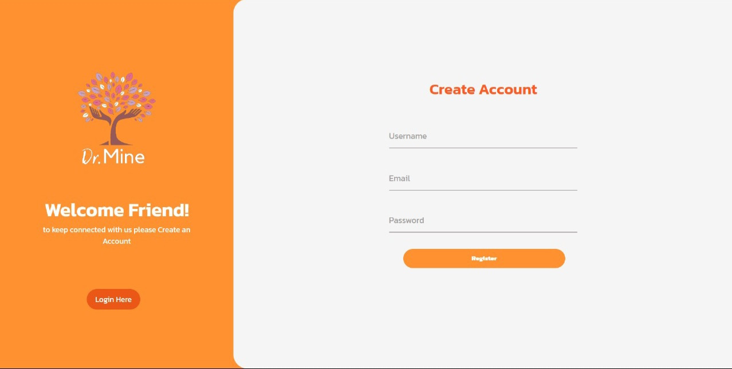

Slide 12
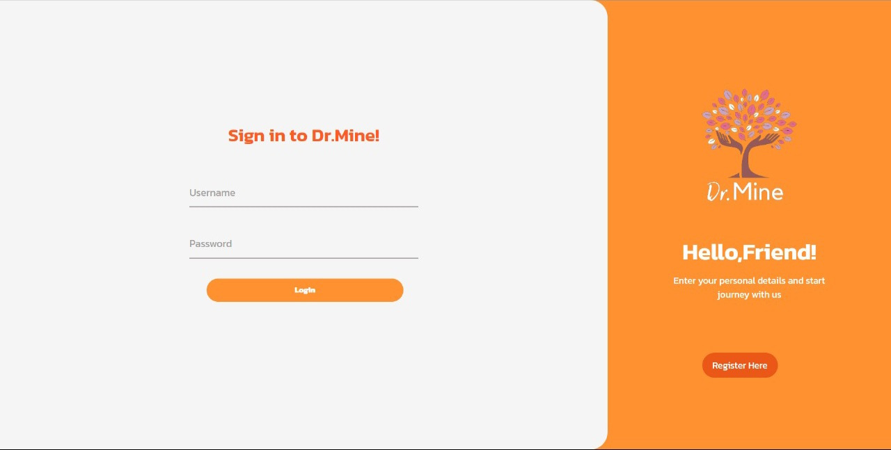

Slide 13
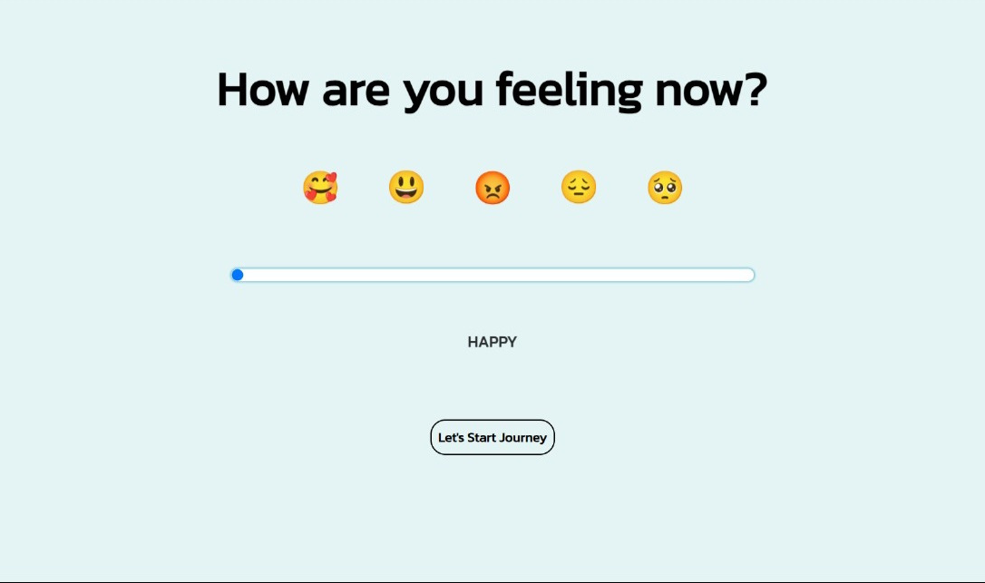

Slide 14
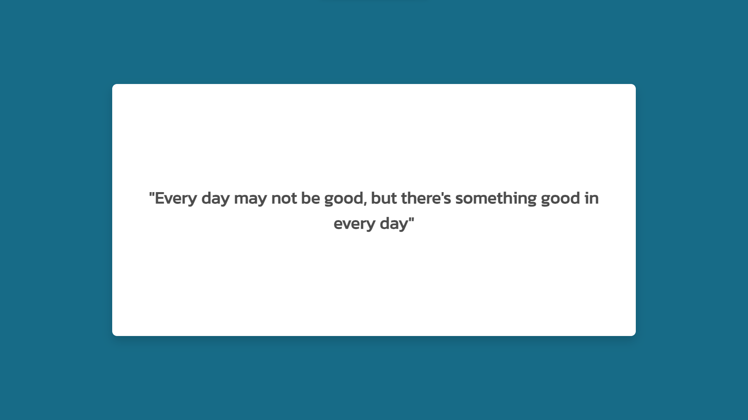

Slide 15
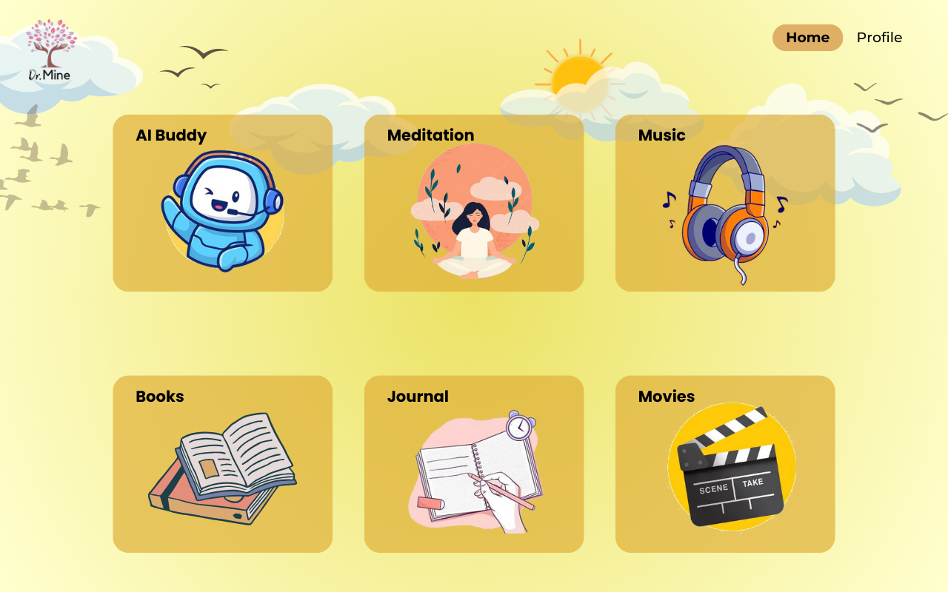

Slide 16
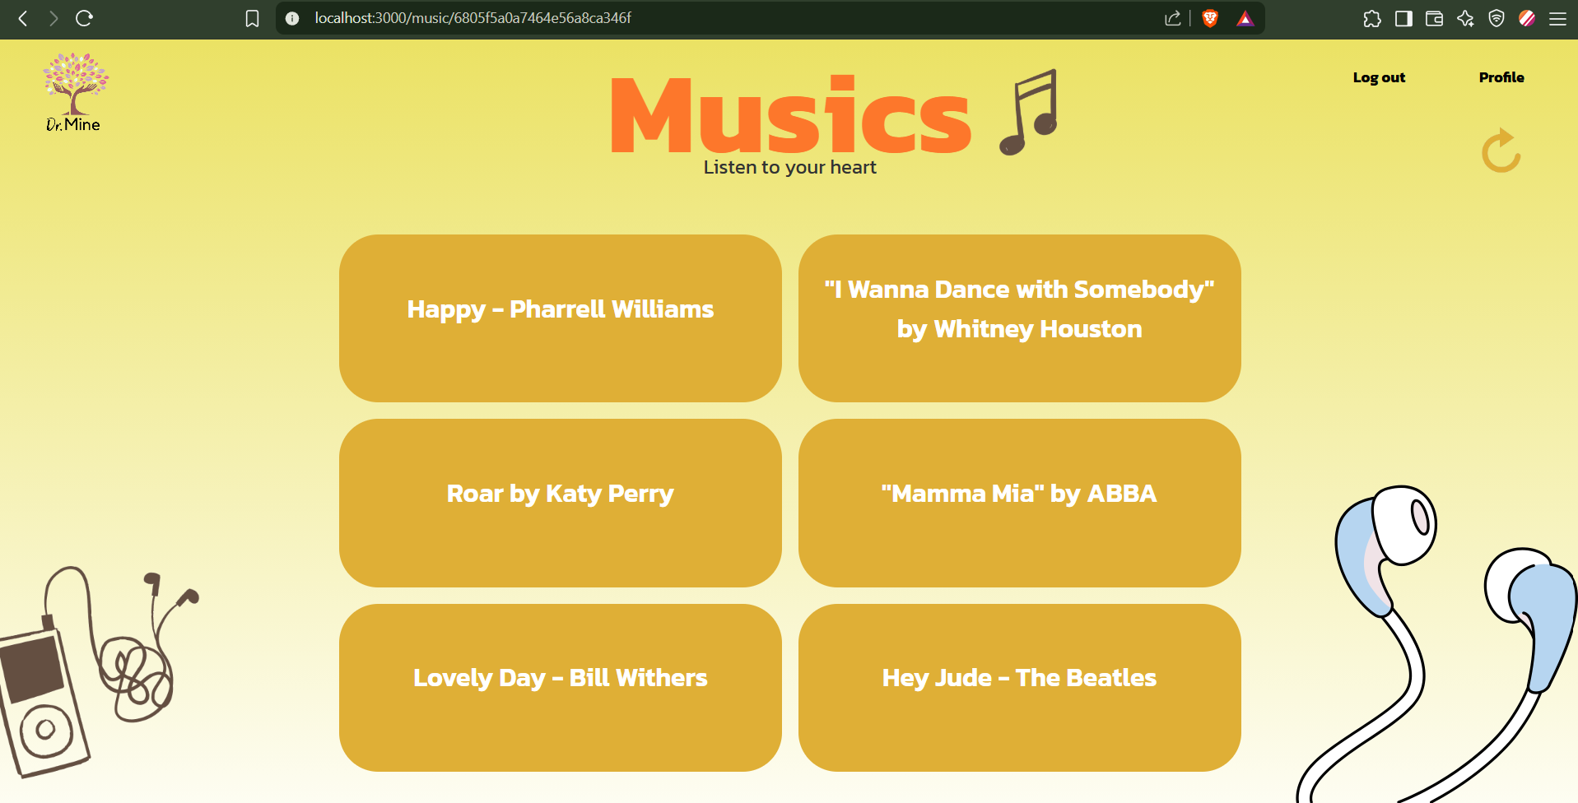

Slide 17
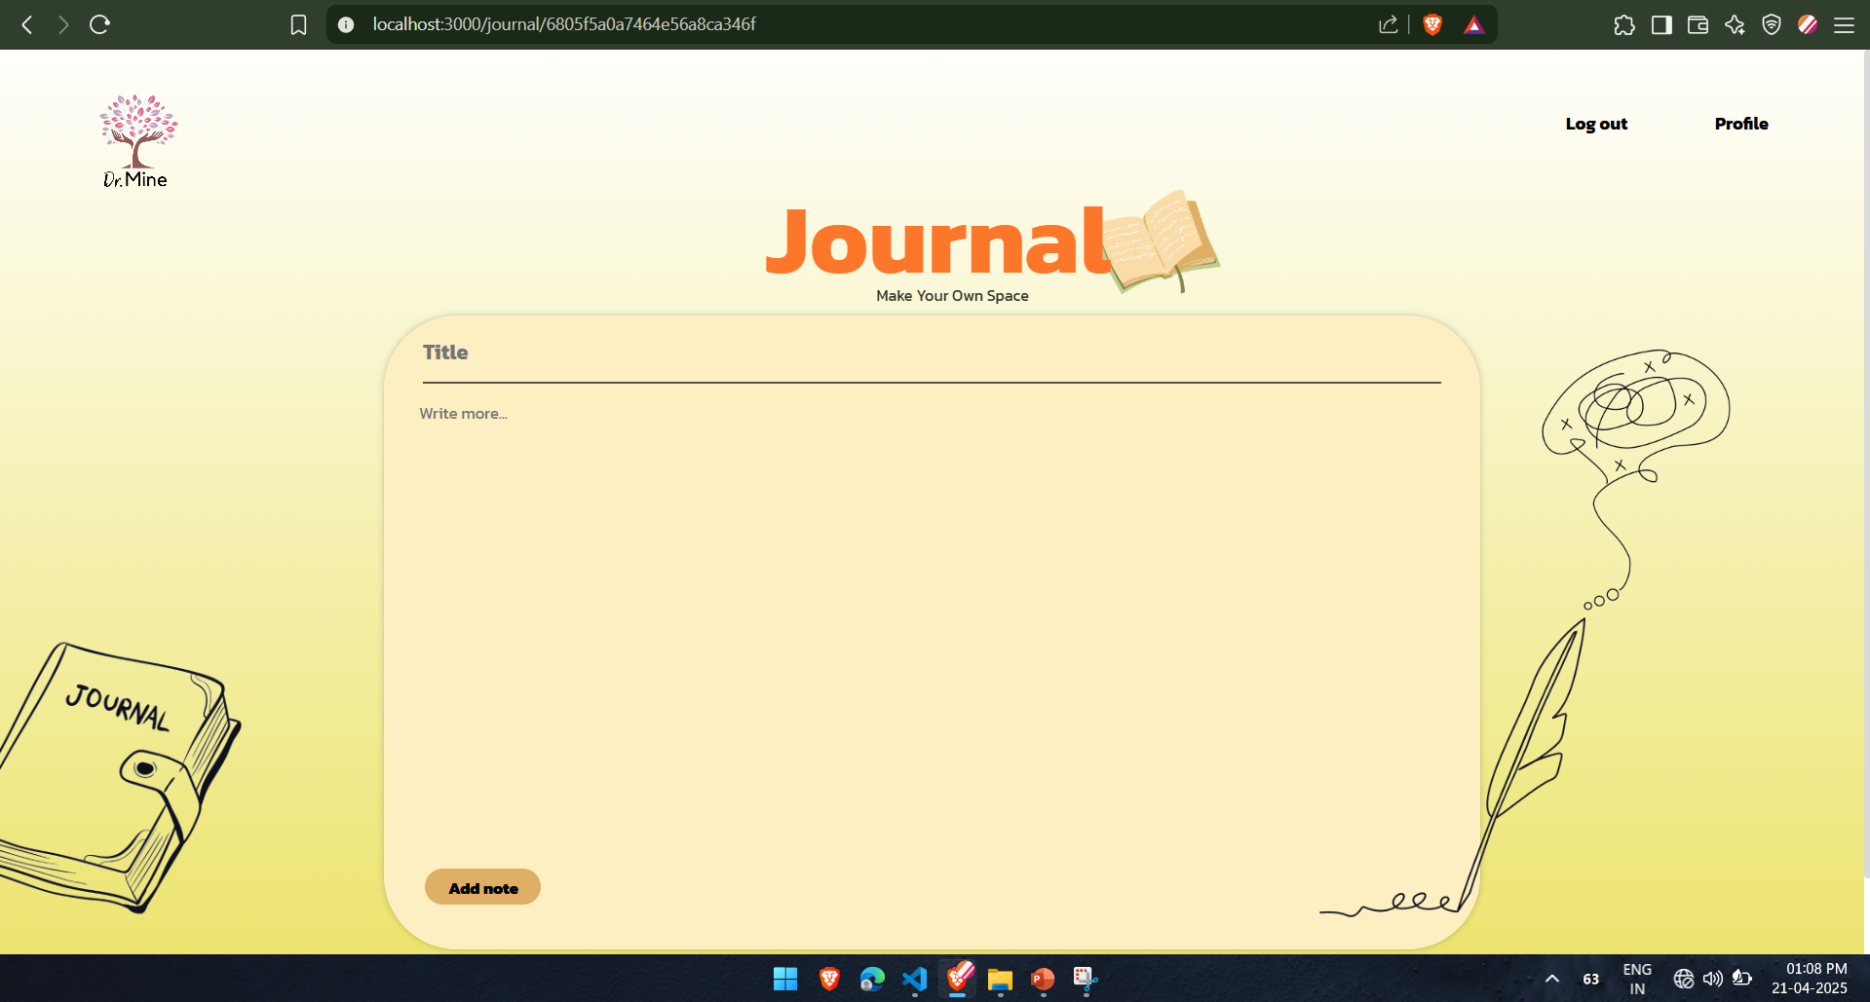

Slide 18
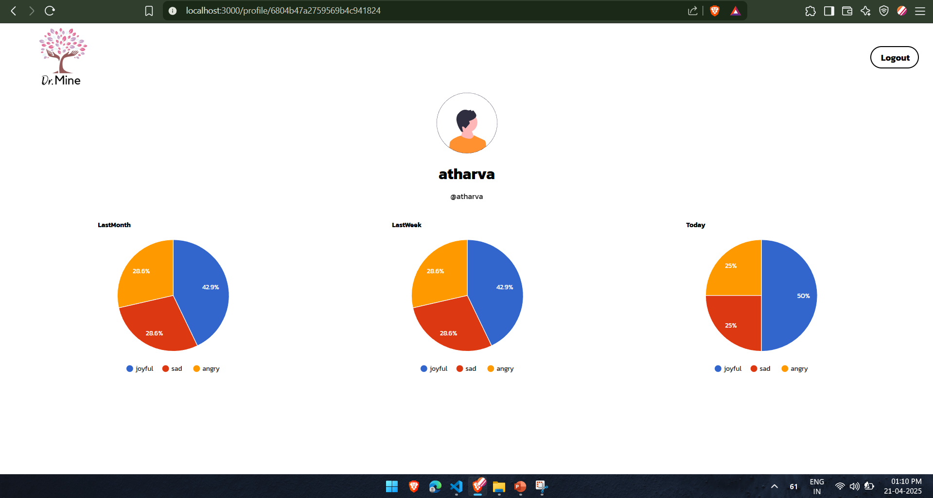
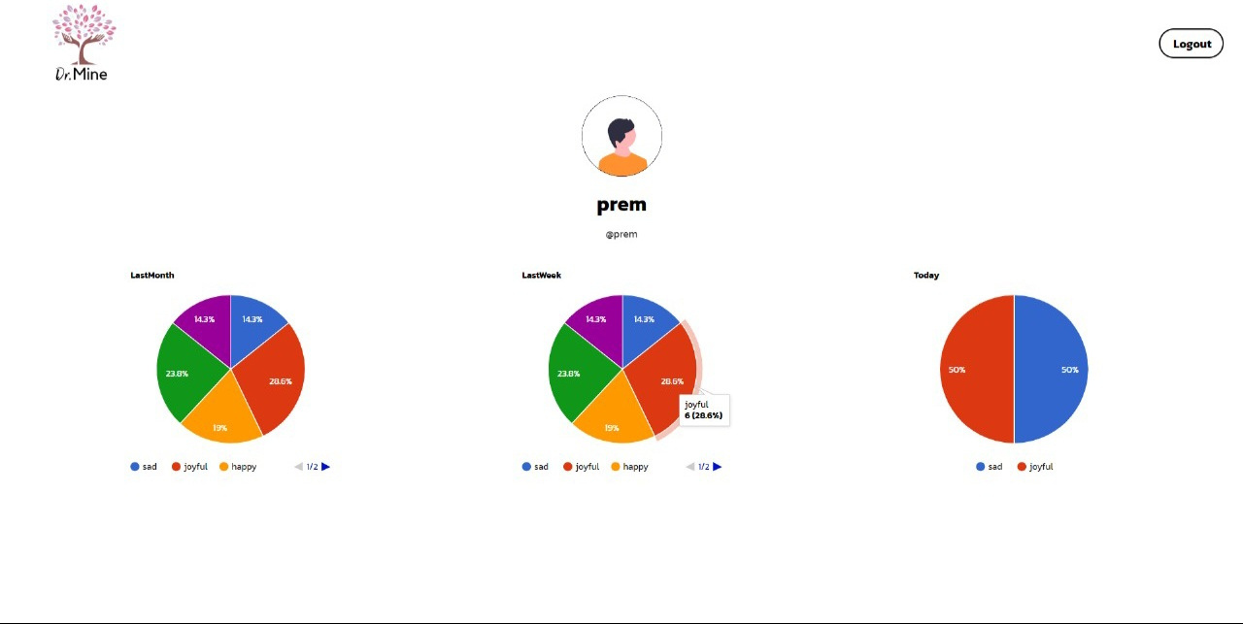

Log out
Most Feeled
%
70%

Slide 19
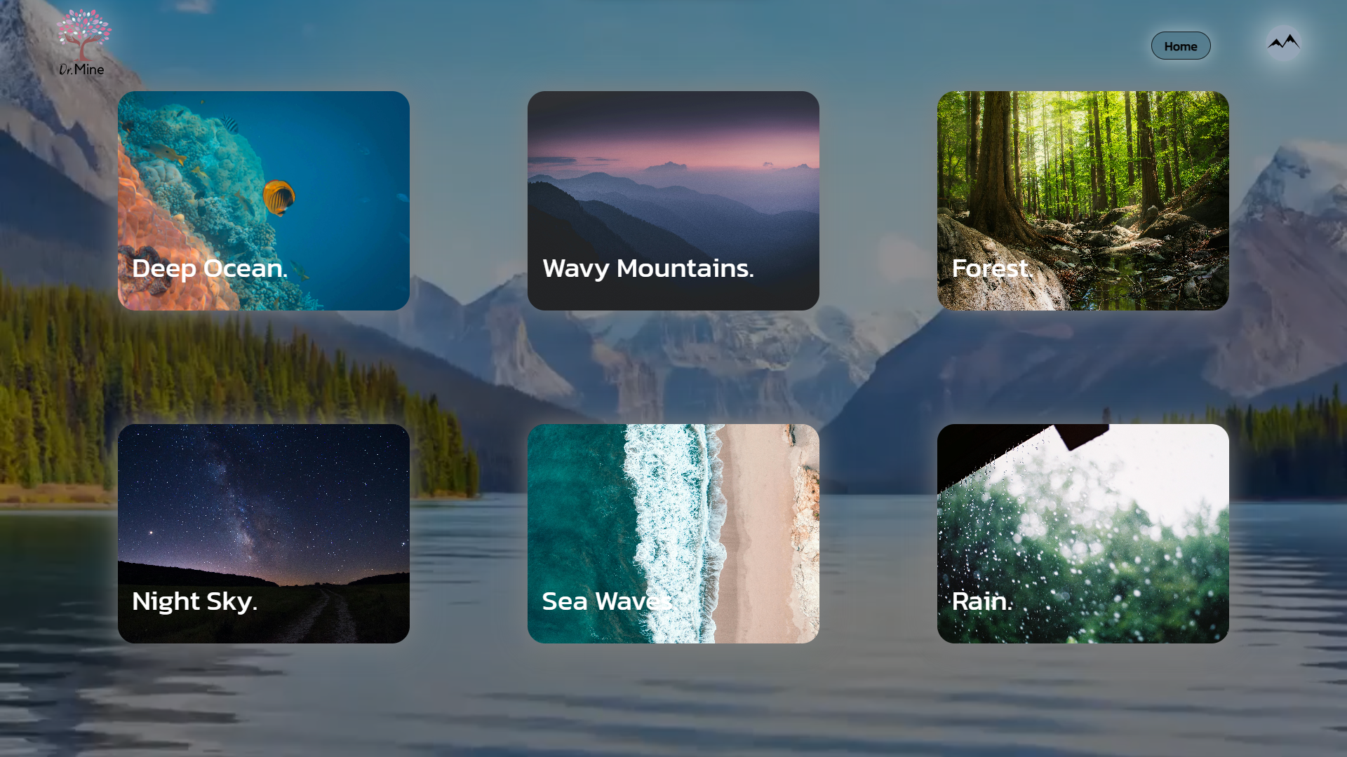

Slide 20
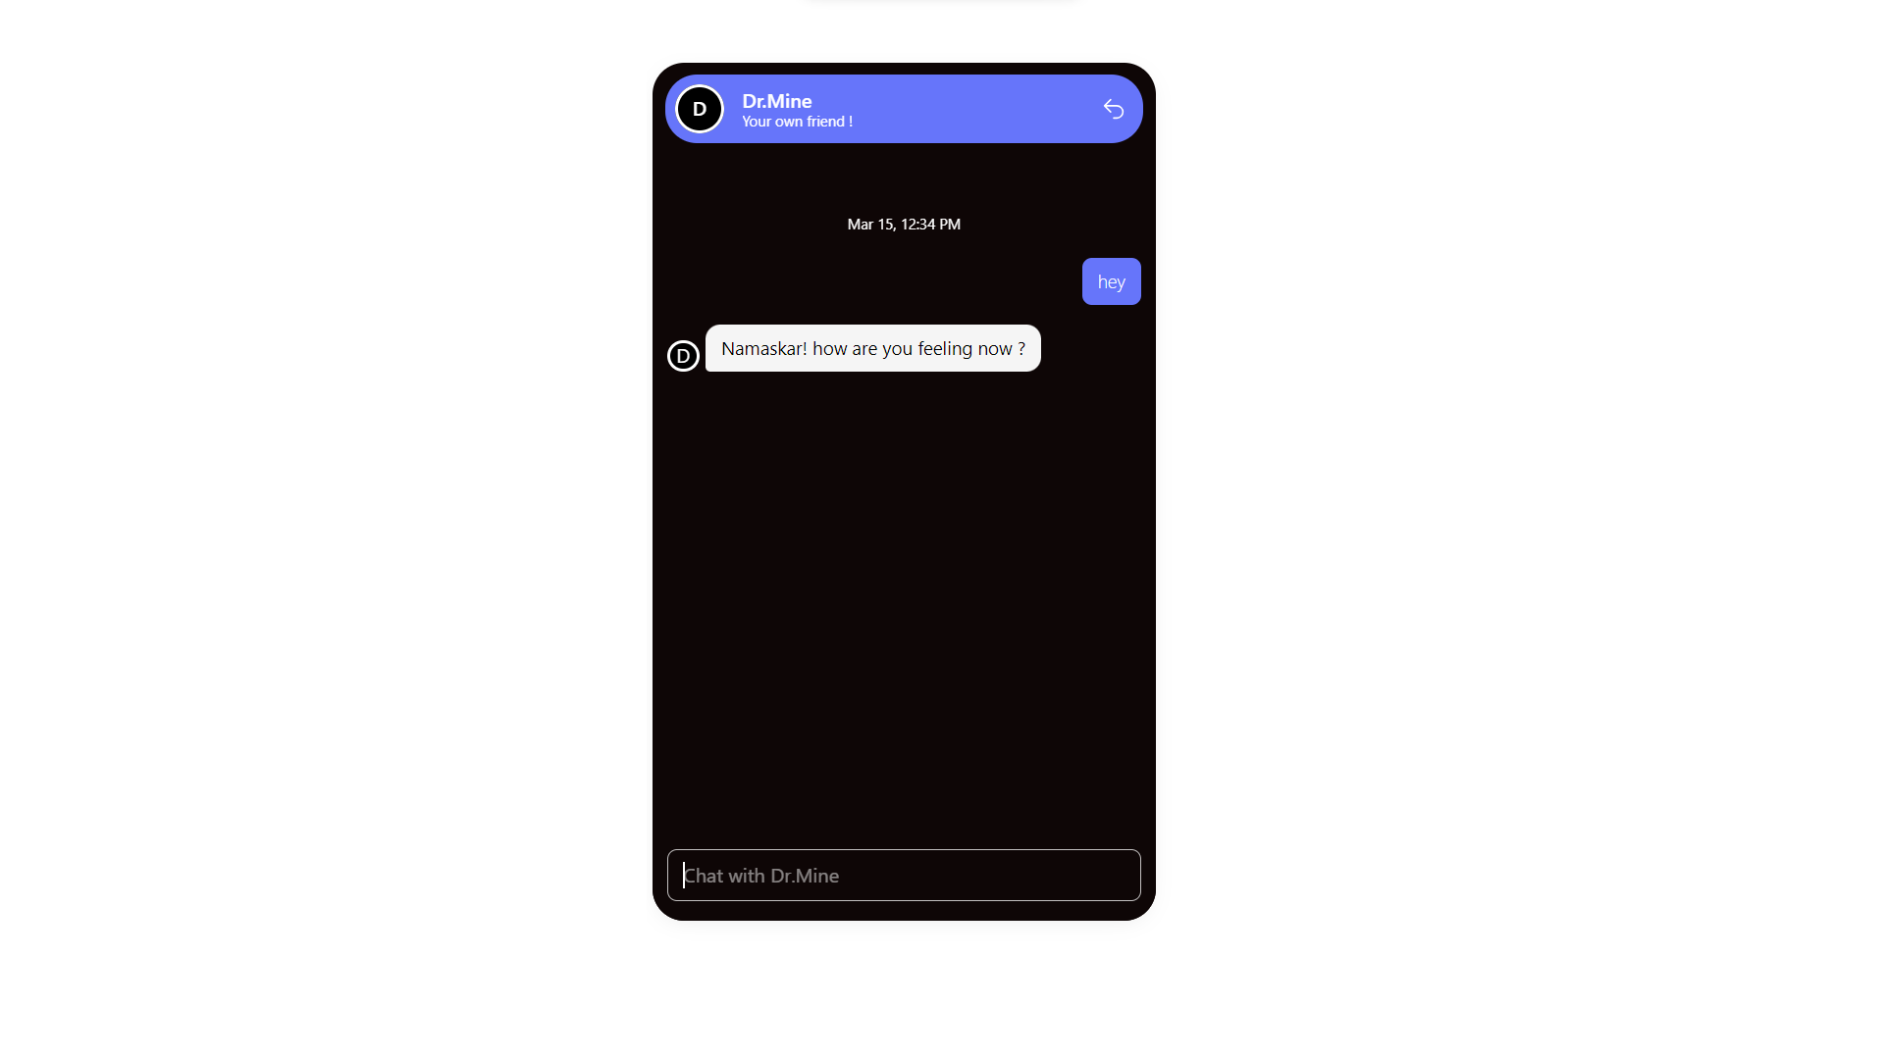

Slide 21
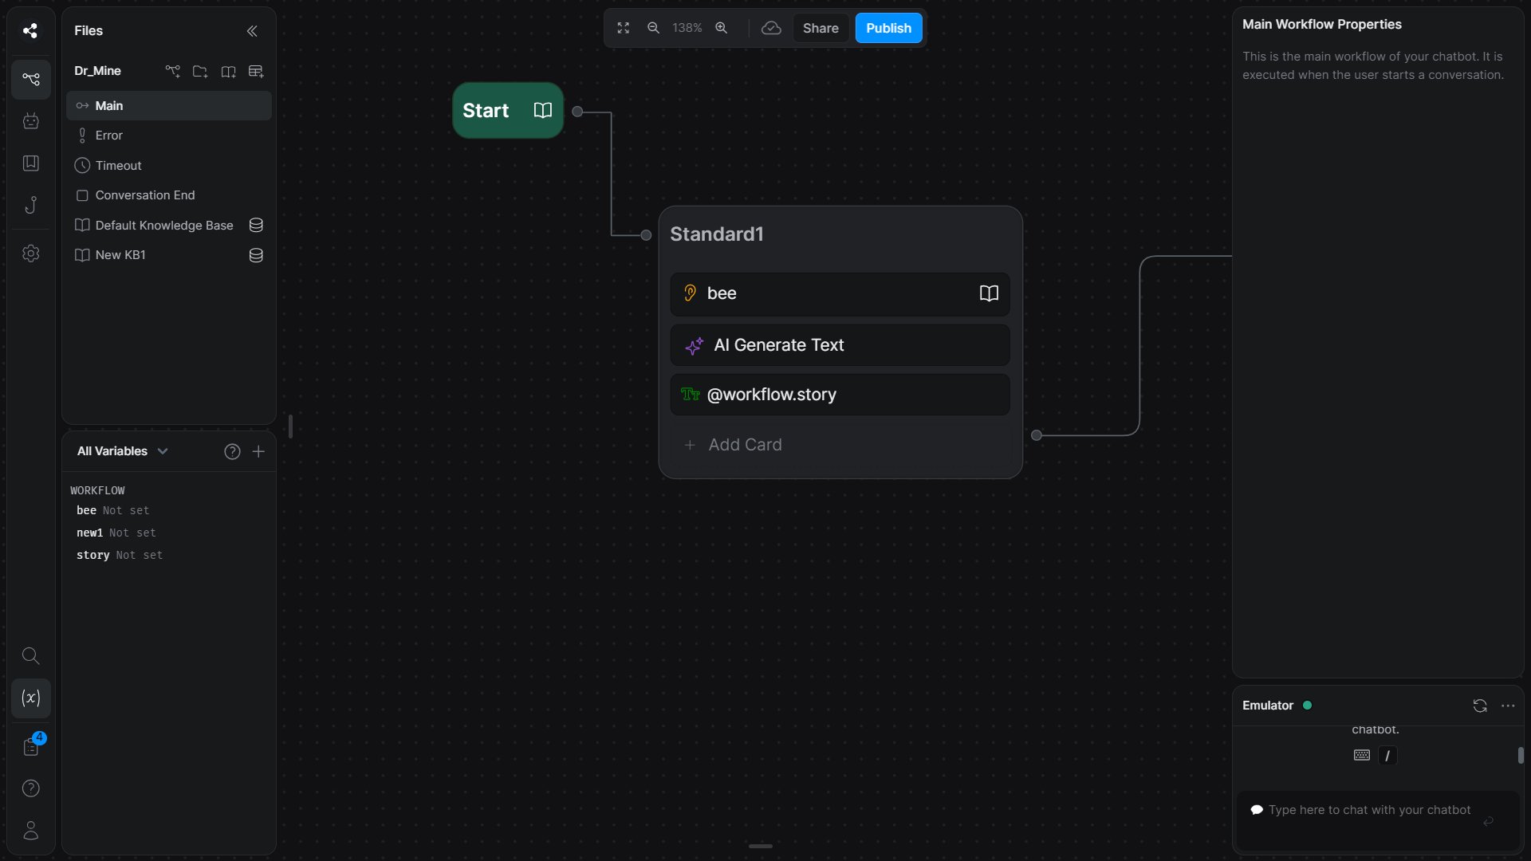

Slide 22



Dr.Mine Logo

Slide 23
Thank You

